Slide 1
Three Phase Induction Motors
Dr. Ramaprasad Panda

Slide 2
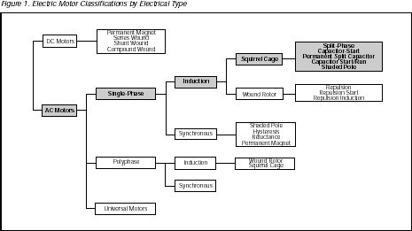
Different Types of Electrical Motors

Slide 3
INTRODUCTION
The three-phase induction motor is the extensively used for various kinds of industrial drives.
AC induction motors are also the most common motors used in main powered home appliances.

Slide 4
Advantages of 3 phase induction motor
Generally easy to build and cheaper than corresponding dc or synchronous motors
Induction motor is robust
The motor is driven by the rotational magnetic field produced by 3 phase currents, hence no commutator or blush is required
Maintenance is relatively easy and at low cost
Satisfactory efficiency and reasonable power factor
A manageable torque-speed curve
Stable operation under load
Range in size from few Watts to several MW

Slide 5
Disadvantages of 3 phase induction motor
Induction motor has low inherent starting torque
Draw large starting currents, typically 6-8 x their full load values
Speeds not easily controlled as DC motors
Operate with a poor lagging power factor when lightly loaded

Slide 6
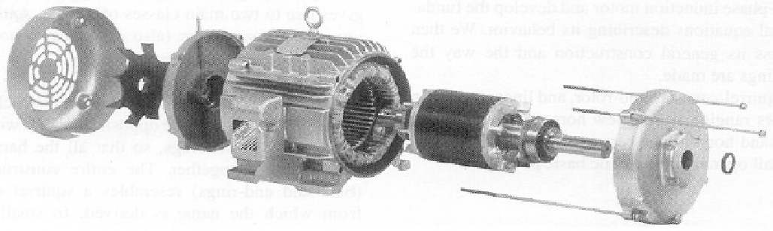
Induction Motor Components
An induction motor has two main parts:
A stator – consisting of a steel frame that supports a hollow, cylindrical core of stacked laminations. Slots on the internal circumference of the stator house the stator winding.
A rotor – also composed of punched laminations, with rotor slots for the rotor winding.
The rotor is separated from the stator by a small air-gap which ranges from 0.4 mm to 4 mm, depending on the power and the size of the motor.

Slide 7
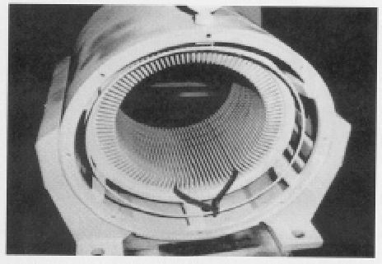
Induction Motor: Stator Winding
Spreading the coil in this manner creates a sinusoidal flux distribution per pole, which improves performance and makes the motor less noisy (sound and electrically).

Slide 8
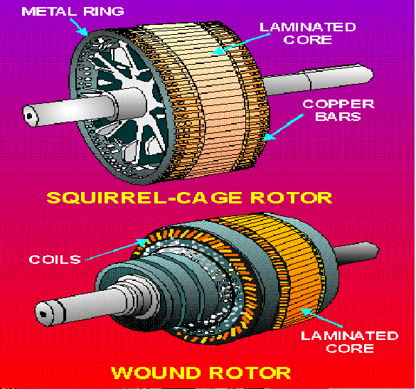
Types of ac induction motor rotors
There are two-types of rotor windings:
Squirrel-cage windings, which produce a squirrel-cage induction motor (most common) Almost 90% of the three-phase AC Induction motors are of this type.
Conventional 3-phase windings made of insulated wire, which produce a wound-rotor induction motor (special characteristics)

Slide 9
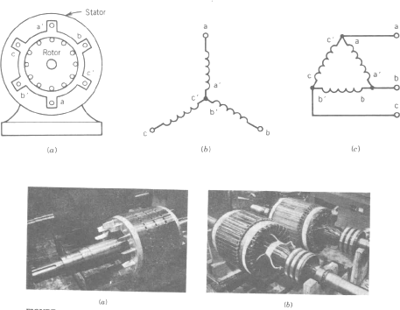
Winding/Rotor Arrangements for 3 Phase Induction Machine

Slide 10
Three Phase Slip Ring Induction Motor
A wound rotor or slip ring motor has a 3-phase winding, similar to the stator winding. The rotor winding terminals are connected to three slip rings which turn with the rotor. The slip rings/brushes allow external resistors to be connected in series with the winding.
Brush
Three Phase Supply
Stator Windings
Rotor Windings
Slip Rings External Resistors
Starting Position
Expensive to manufacture and it is vulnerable to overheat
but we can control the starting torque and running characteristics

Slide 11
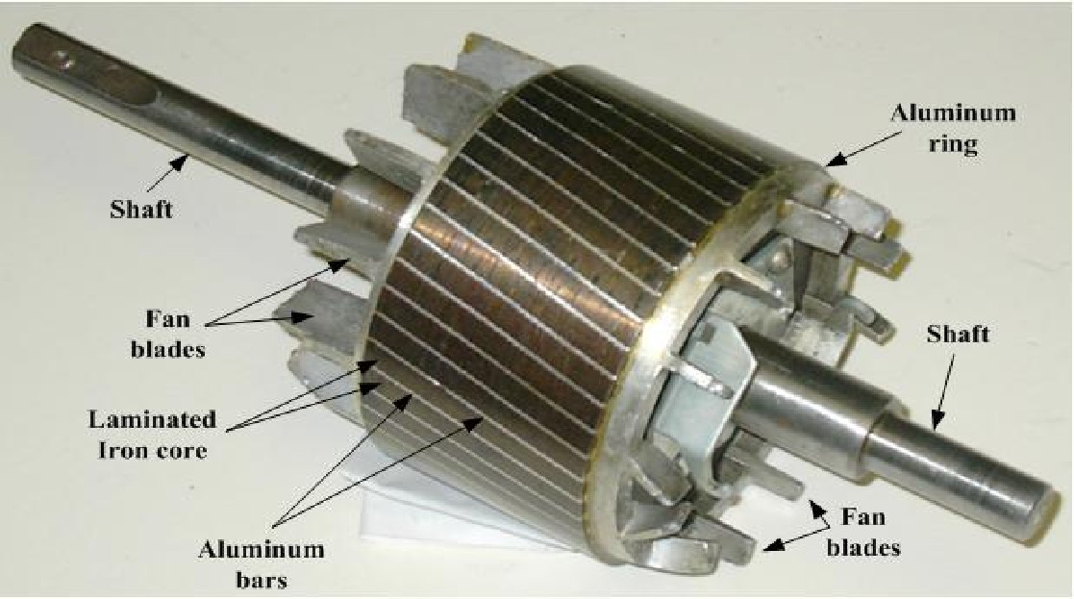
Squirrel Cage Rotor

Slide 12
Rotating Field Concept
Before discussing the theory of operation for the induction motor a very basic concept, that of a rotating field, must be understood.
A rotating and constant resultant magnetic field rotating at a constant speed may be produced by any three-phase group of windings displaced in space if the currents flowing through the windings are also displaced in time.

Slide 13
Operation Principle
The three fluxes generated by the phase windings are separated by 120° in space and in time for a two-pole motor
The total flux in the machine is the sum of the three fluxes.
The summation of the three ac fluxes results in a rotating flux, which turns with constant speed and has constant amplitude.
The rotating flux induces a voltage in the short-circuited bars of the rotor. This voltage drives current through the bars.
The interaction of the rotating flux and the rotor current generates a force that drives the motor.
The force is proportional with the flux density and the rotor bar current
The voltage and current generation in the rotor bar require a speed difference between the rotating field and the rotor.
Consequently, the rotor speed is always less than the magnetic field speed.

Slide 14
For an induction motor with P poles and f frequency,
120 f
P
The speed of the rotating field:
n_{s} =
n_{m}
Rotor Speed:
n_{s} - n_{m}
Slip Speed:
n_{s} - n_{m}
n_{s}
Slip:
f _{R} = s f
The frequency in the rotor:
f_{R} = frequency of rotor voltage and current

Slide 15

Slip
For induction motors a very important parameter is the slip of the
motor The slip, s, defines the relative speed difference between synchronous speed and rotor speed and is given by:
where ω is expressed in rads/s and n is expressed in rpm.
At no-load, the slip is nearly zero (<0.1%).
At full load, the slip for large motors rarely exceeds 0.5%. For small motors at full load, it rarely exceeds 5%.
The slip is 100% for locked rotor (Starting).

Slide 16
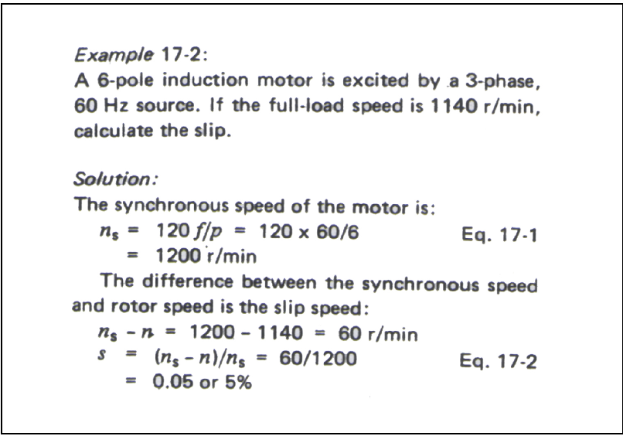

Slide 17
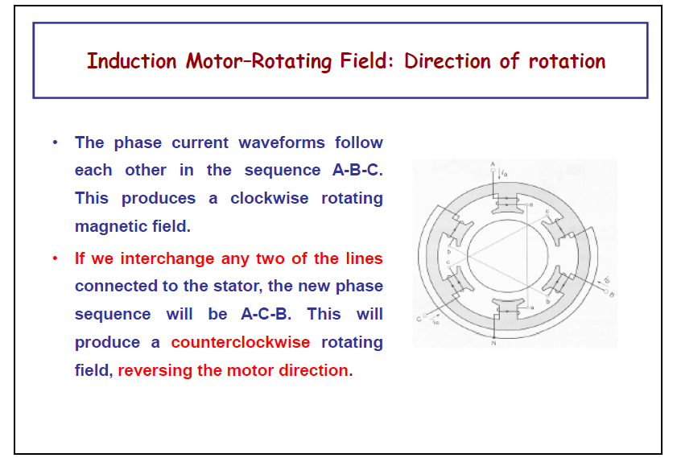

Slide 18
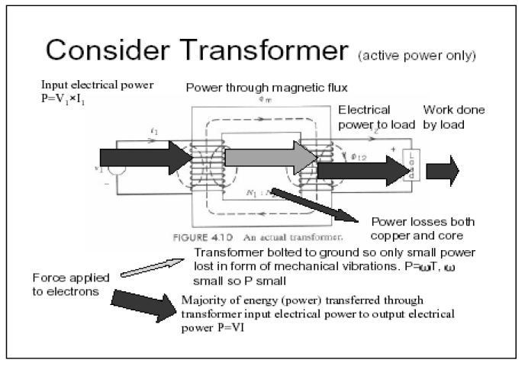

Slide 19
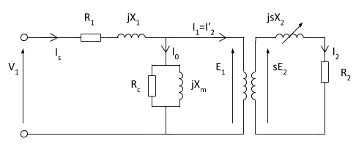
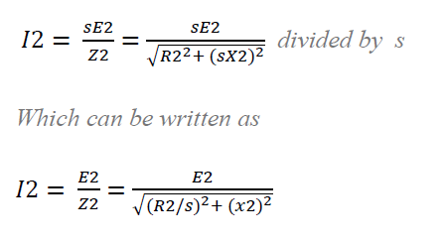
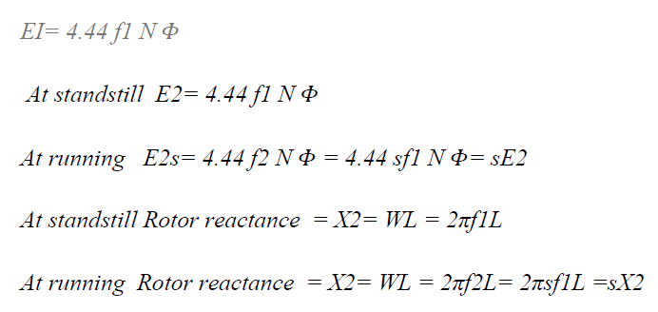
Equivalent circuit of three phase induction motor

Slide 20
Torque Equation
T ∝ ɸ I₂ cosɸ₂ OR T = k ɸ I₂ cosɸ₂ . where, ɸ = flux per stator pole, I₂ = rotor current at standstill, ɸ₂ = angle between rotor emf and rotor current, k = a constant. Now, let E₂ = rotor emf at standstill we know, rotor emf is directly proportional to flux per stator pole, i.e. E₂ ∝ ɸ. therefore, T ∝ E₂ I₂ cosɸ₂ OR T =k₁ E₂ I₂ cosɸ₂

Slide 21



Starting torque
The constant k1 = 3 / 2πNs

Slide 22



Running Torque
T ∝ ɸ I_{r} cosɸ₂ .
where, E_{r} = rotor emf per phase under running condition = sE₂. (s=slip), I_{r} = rotor current per phase under running condition
reactance per phase under running condition will be = sX₂
therefore,
as, ɸ ∝ E₂.

Slide 23
Condition for Maximum Torque
For maximum torque at starting:
R₂=X₂
For Maximum Torque at running
R₂=SX₂ or
S_{max}=(R₂/X₂₎

Slide 24
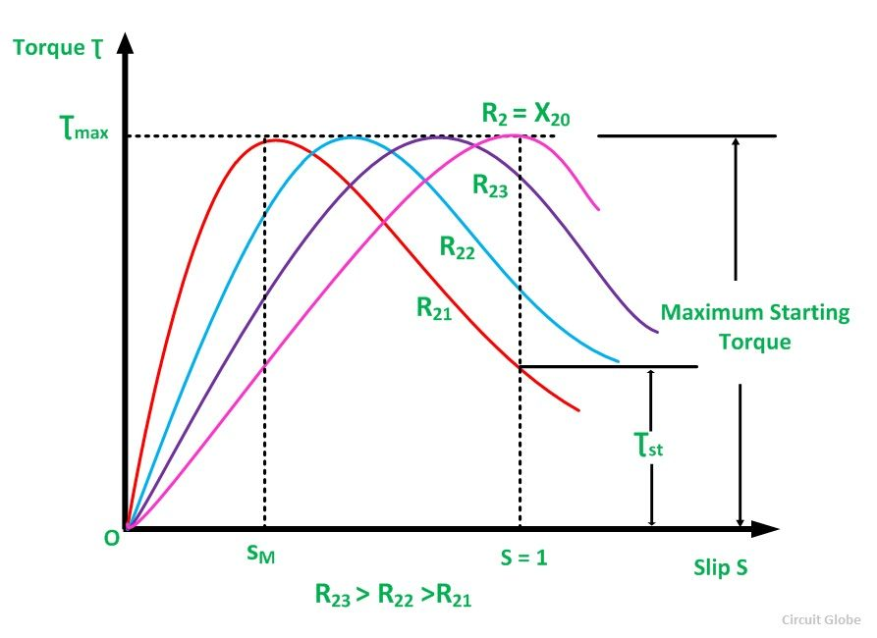



Torque Slip Characteristic
Low Slip Region
Medium Slip Region
High Slip Region
Beyond the maximum torque point, the value of torque starts decreasing. As a result, the motor slows down and stops.
The motor operates for the values of the slip between s = 0 and s = s_{M}. Where, s_{M} is the value of the slip corresponding to the maximum torque. For a typical induction motor, the pull-out torque is 2 to 3 times the rated full load torque. The starting torque is about 1.5 times the rated full load torque.

Slide 25
Examples -1
A 12 pole, 3 phase alternator is coupled to an engine running at 500 rpm. It supplies an Induction Motor which ahs a full load speed of 1440 rpm. Find the percentage slop and the number of poles of the motor.

Slide 26
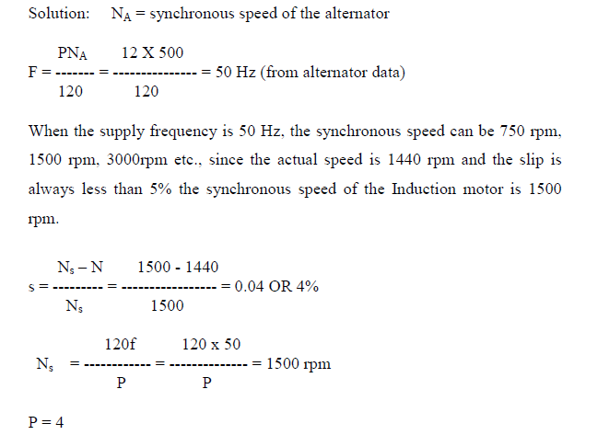

Slide 27
Example-2
A 12 pole, 3 phase alternator is driven by a 440V, 3 phase, 6 pole Induction Motor running at a slip of 3%. Find frequency of the EMF generated by the alternator.

Slide 28
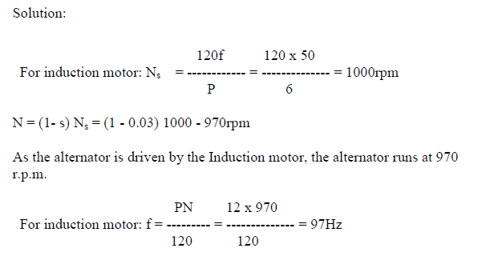

Slide 29
Example-3
A 4-pole, 30hp, 3-phase 400 volts, 50Hz induction motor operates at an efficiency of 0.85 with a power factor of 0.75(lag). Calculate the current drawn by the induction motor from the mains.

Slide 30
